Slide 1
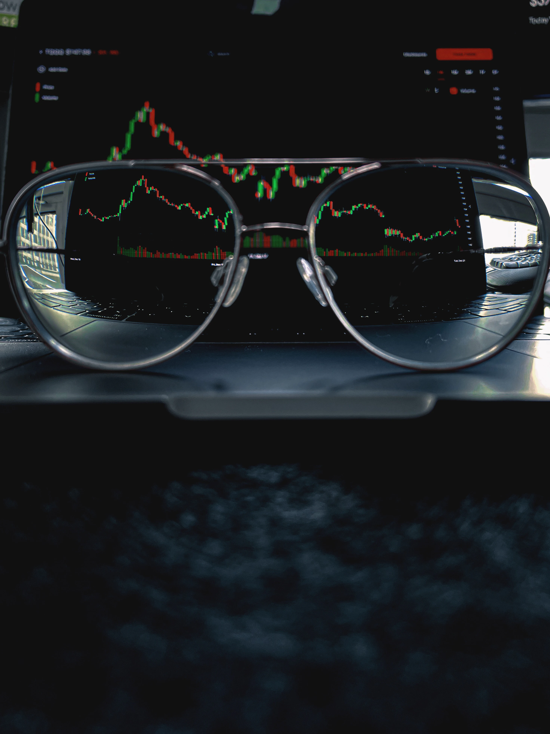

Stimulating Traders.
a
Capturing Alpha amidst of the current Macro Landscape.
Our pitch to the AwareSuper Investment Committee.

Slide 2
Here are the problems that we are solving for…
Problem 1
Macro
Micro
Problem 2
Problem 3
Introduction
Interest Rate (IR)
Foreign Exchange (FX)
Equity Index (EI)
Conclusion

Slide 3


…wearing these hats as Investors of the markets
Stimulating Traders Dynamic Duo – A Portfolio Manager and Trader
Life of a Trade, from A to Z
From an ex-BlackRock Analyst to Winner of UNIT Trading Competition
Speaking to brokers to get the best Price
1
2
3
3
4
5
6
With a killer strategy to capture alpha
Introduction
Interest Rate (IR)
Foreign Exchange (FX)
Equity Index (EI)
Conclusion

Slide 4



Executive summary
Asset Class
Our Strategy to Capturing Alpha
IR:
FX:
EI:
Introduction
Interest Rate (IR)
Foreign Exchange (FX)
Equity Index (EI)
Conclusion

Slide 5
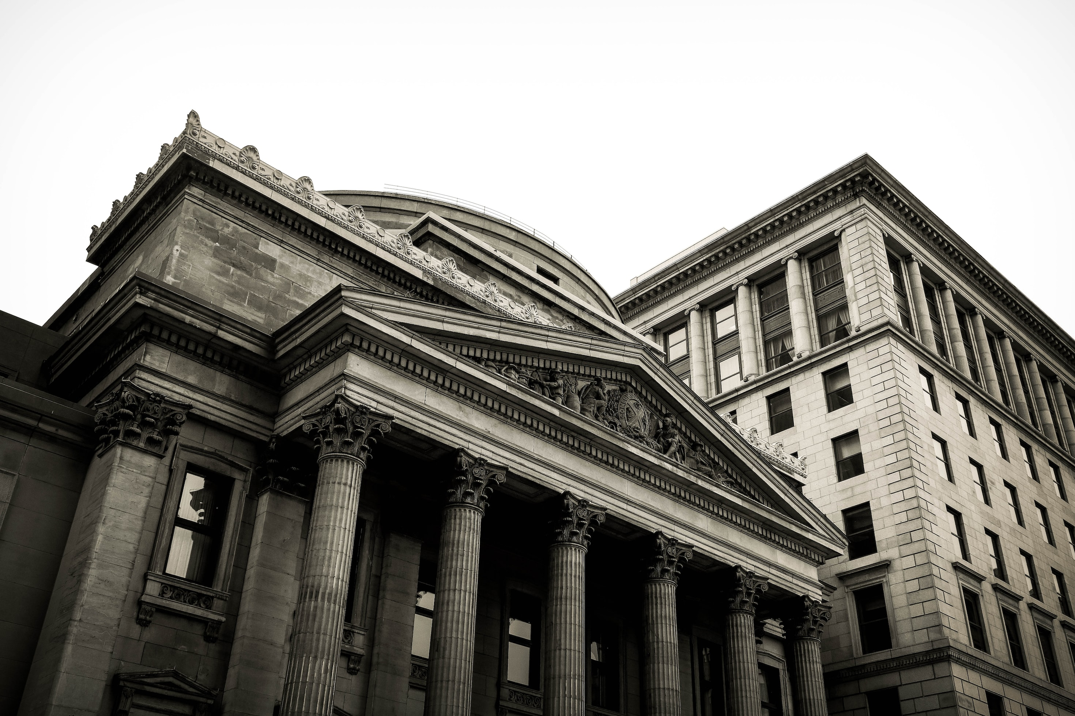
Interest Rates (IR).
Xyz..
Xyz..

Slide 6
Macroeconomics/Microeconomics #1
Introduction
Interest Rate (IR)
Foreign Exchange (FX)
Equity Index (EI)
Conclusion

Slide 7
Our Strategy#2
Introduction
Interest Rate (IR)
Foreign Exchange (FX)
Equity Index (EI)
Conclusion

Slide 8
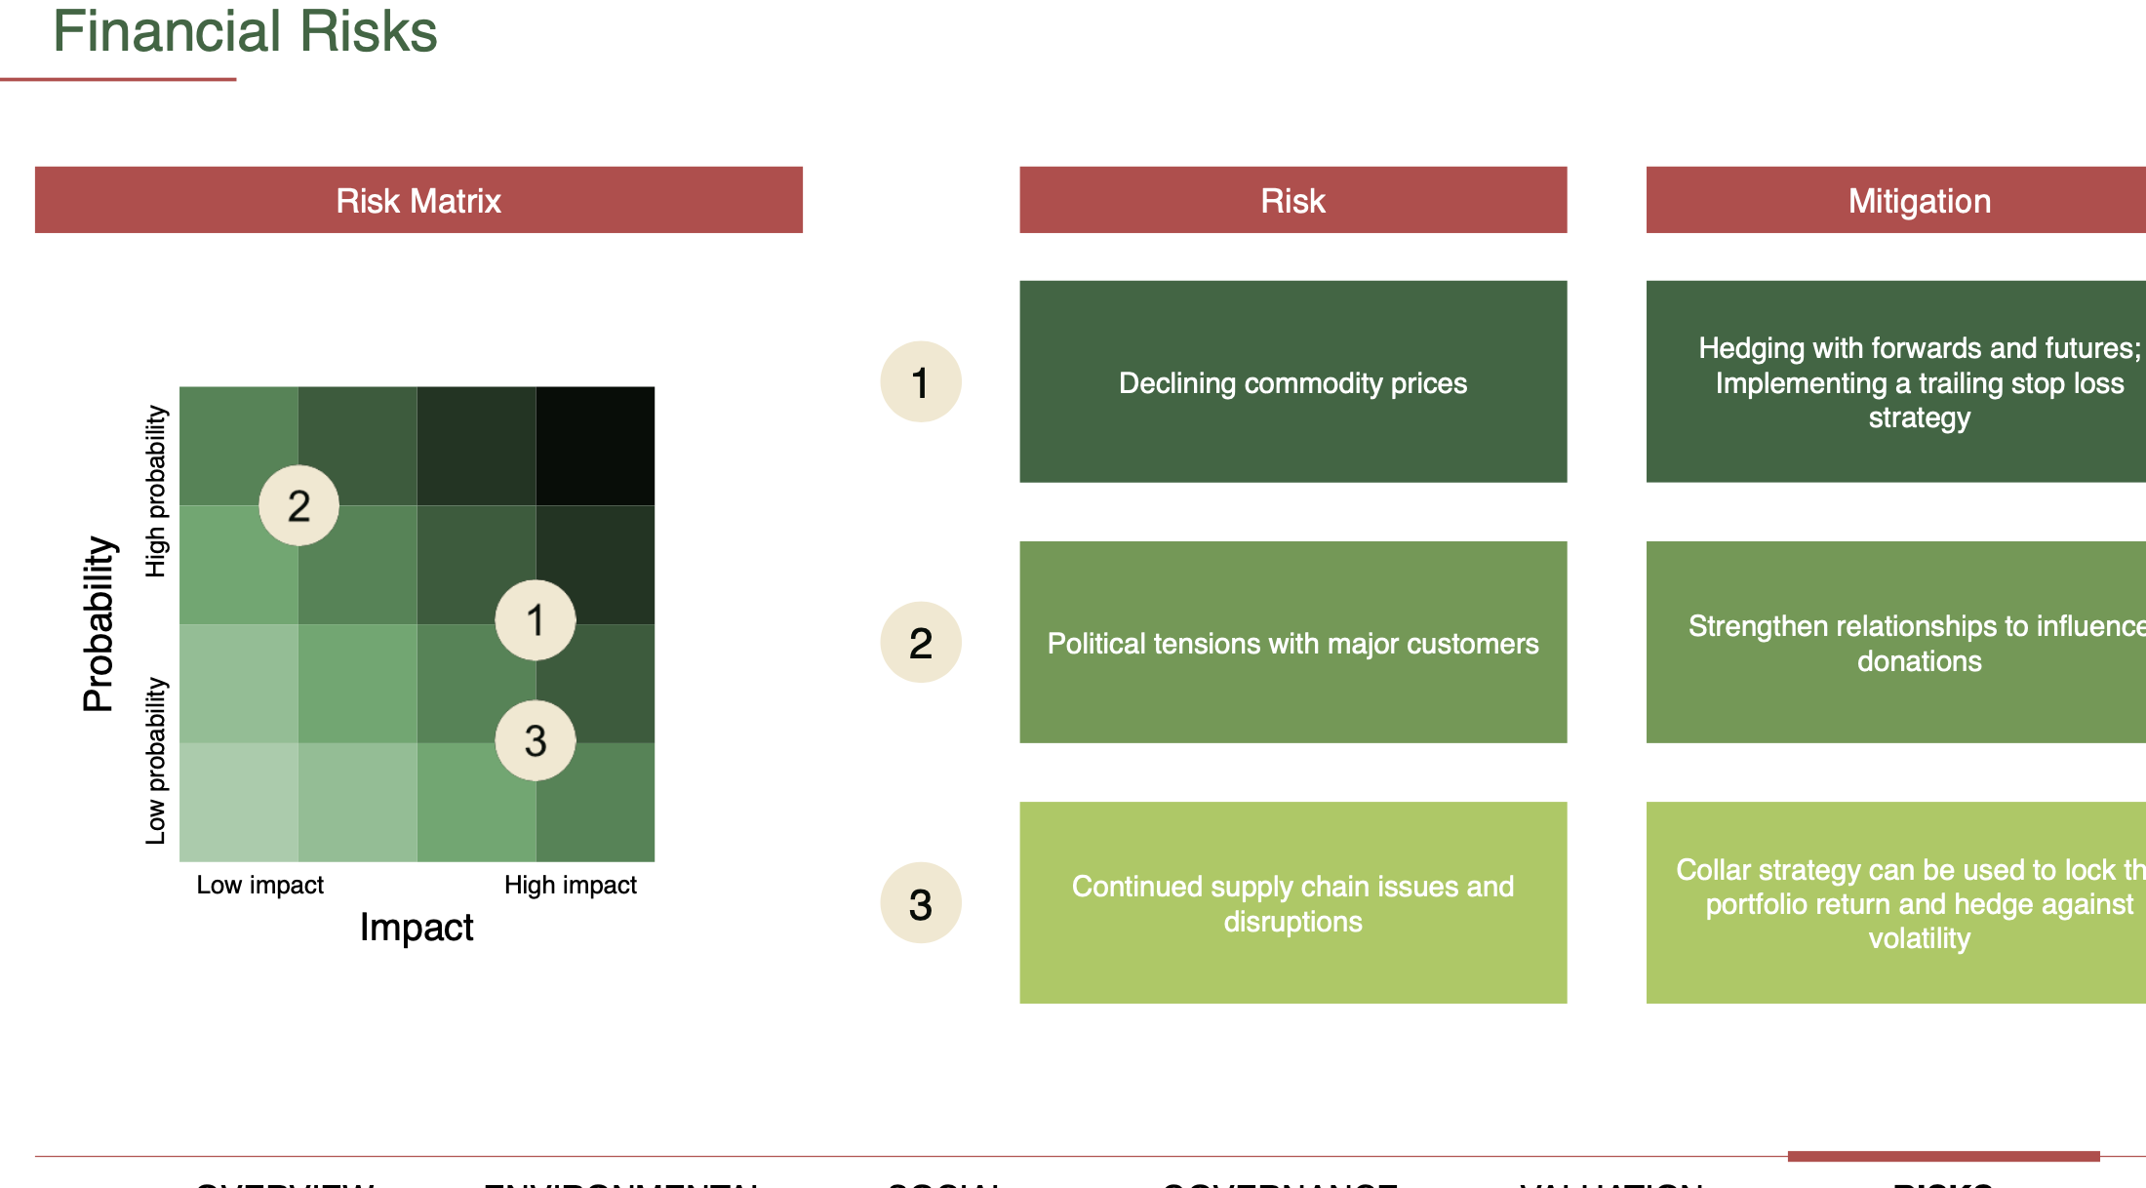
Key Risks & Opportunities #3
Introduction
Interest Rate (IR)
Foreign Exchange (FX)
Equity Index (EI)
Conclusion
Notes:
What are the key risks/oppotunities

Slide 9
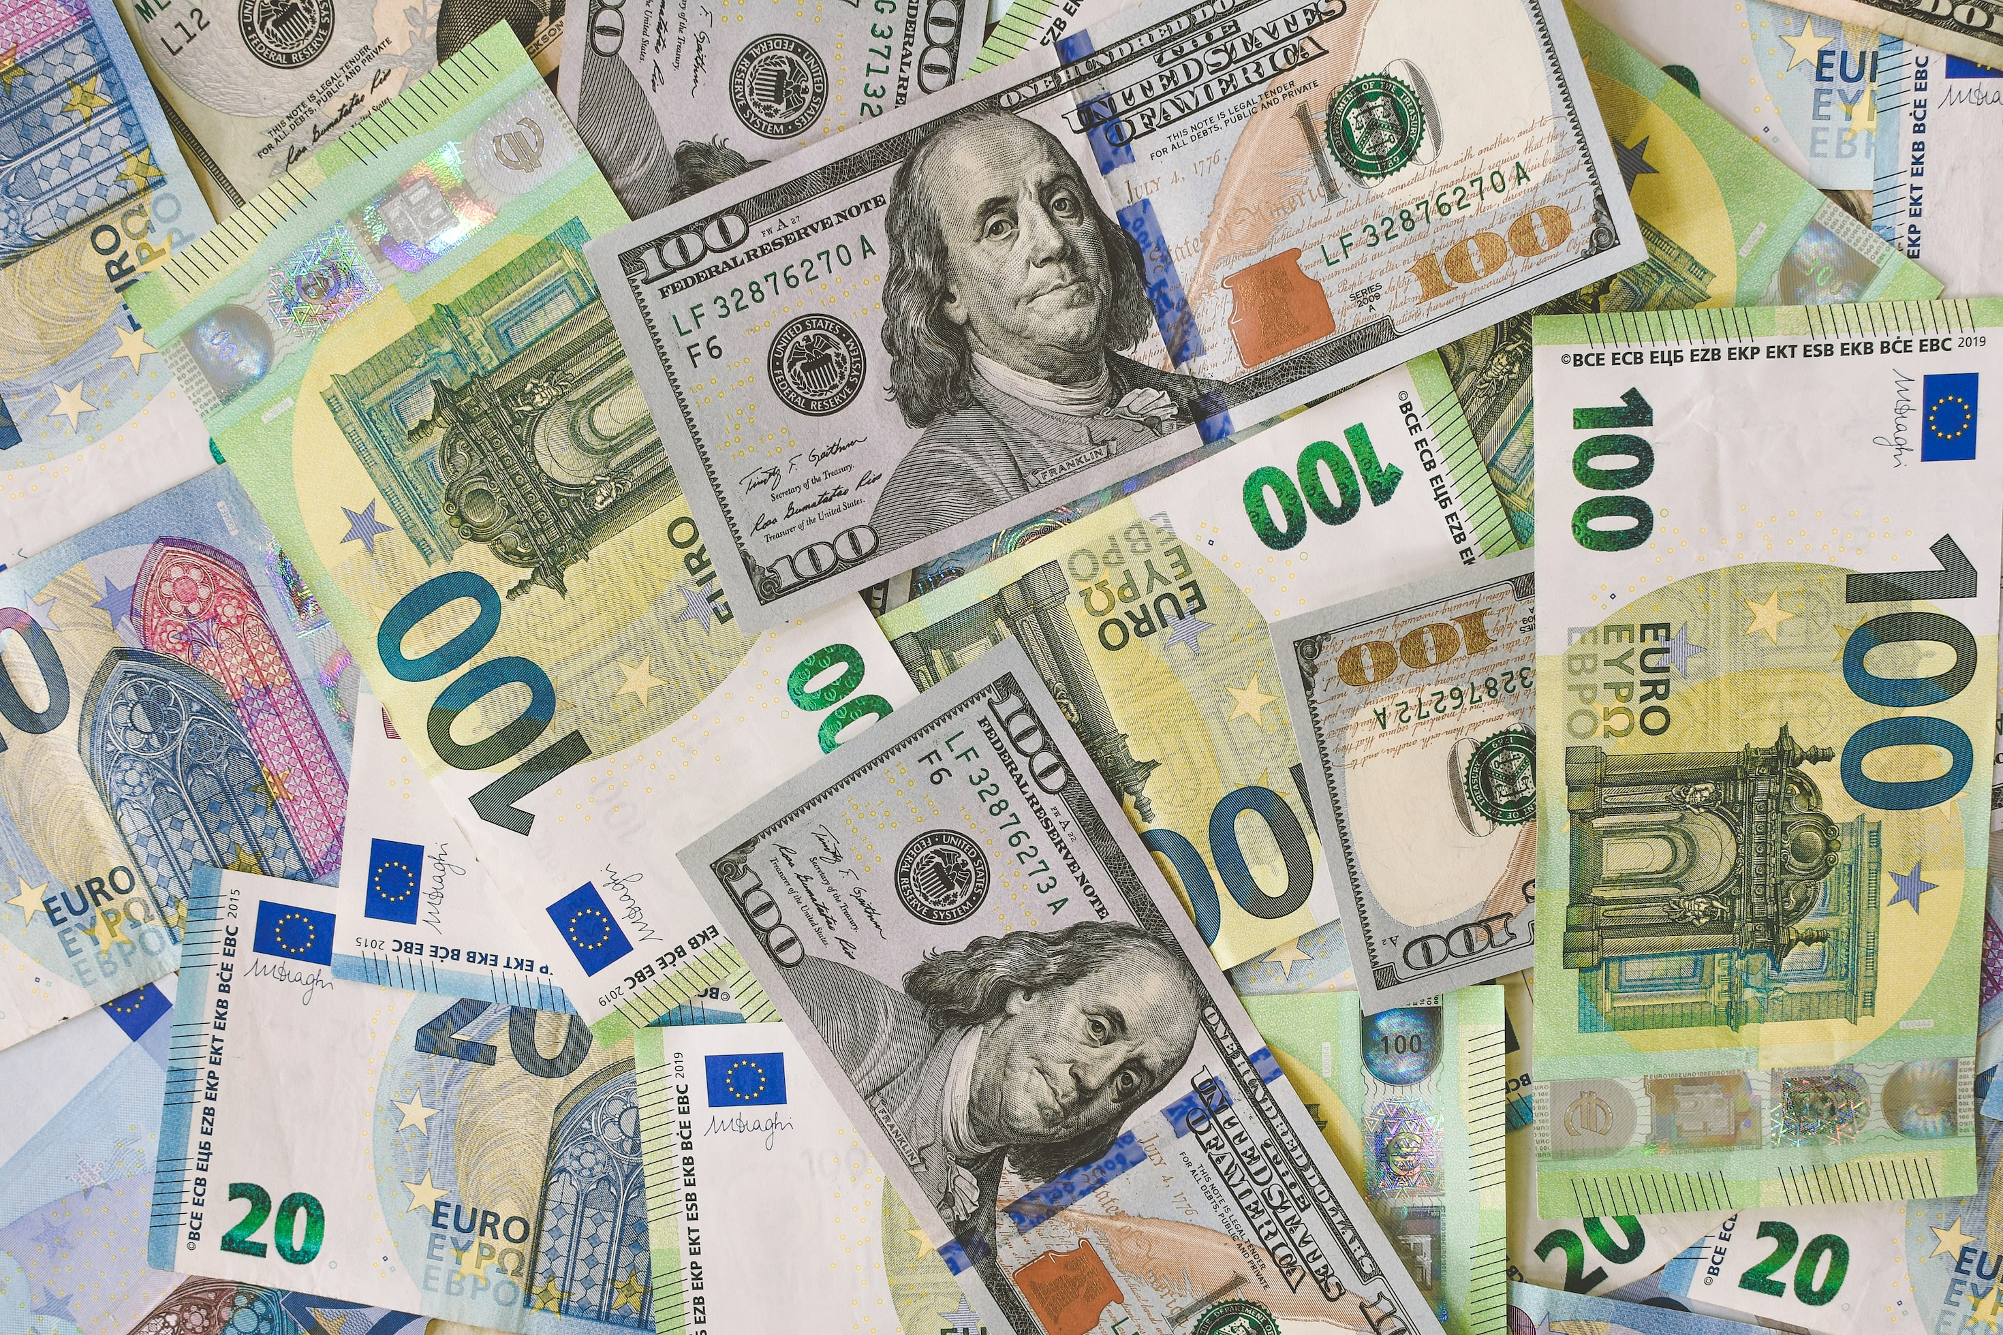
Foreign Exchange (FX).
z
Xyz..
Xyz..

Slide 10
Macro/Micro#1
Introduction
Interest Rate (IR)
Foreign Exchange (FX)
Equity Index (EI)
Conclusion

Slide 11
Our Strategy #2
Introduction
Interest Rate (IR)
Foreign Exchange (FX)
Equity Index (EI)
Conclusion

Slide 12
Key Risks & Opportunities #3
Introduction
Interest Rate (IR)
Foreign Exchange (FX)
Equity Index (EI)
Conclusion

Slide 13

Equity Index (EI).
Xyz..
Xyz..

Slide 14
Macro/Micro #1
Introduction
Interest Rate (IR)
Foreign Exchange (FX)
Equity Index (EI)
Conclusion

Slide 15
Our Strategy #2
Introduction
Interest Rate (IR)
Foreign Exchange (FX)
Equity Index (EI)
Conclusion

Slide 16
Key Risks & Opportunities #3
Introduction
Interest Rate (IR)
Foreign Exchange (FX)
Equity Index (EI)
Conclusion

Slide 17

And to wrap up our pitch…
Xyz..
Xyz..

Slide 18
Frequently asked questions (FAQs)
What is your view of the market one year from now?
Can you walk me through your financials?
What factors would disprove your investment thesis?
Why Technical Analysis over Fundamental Analysis?
What are the cost-benefit of this strategy to our portfolio?
Introduction
Interest Rate (IR)
Foreign Exchange (FX)
Equity Index (EI)
Conclusion

Slide 19
So, here is our conclusion…
Introduction
Interest Rate (IR)
Foreign Exchange (FX)
Equity Index (EI)
Conclusion

Slide 20


Questions and Answers.
Capturing Alpha amidst of the current Macro Landscape.
Our pitch to the AwareSuper Investment Committee.

Slide 21
Garbage

Slide 22
And these are our strategy for capturing alpha

